Slide 1
Logic Puzzles and Comparatives

Slide 2
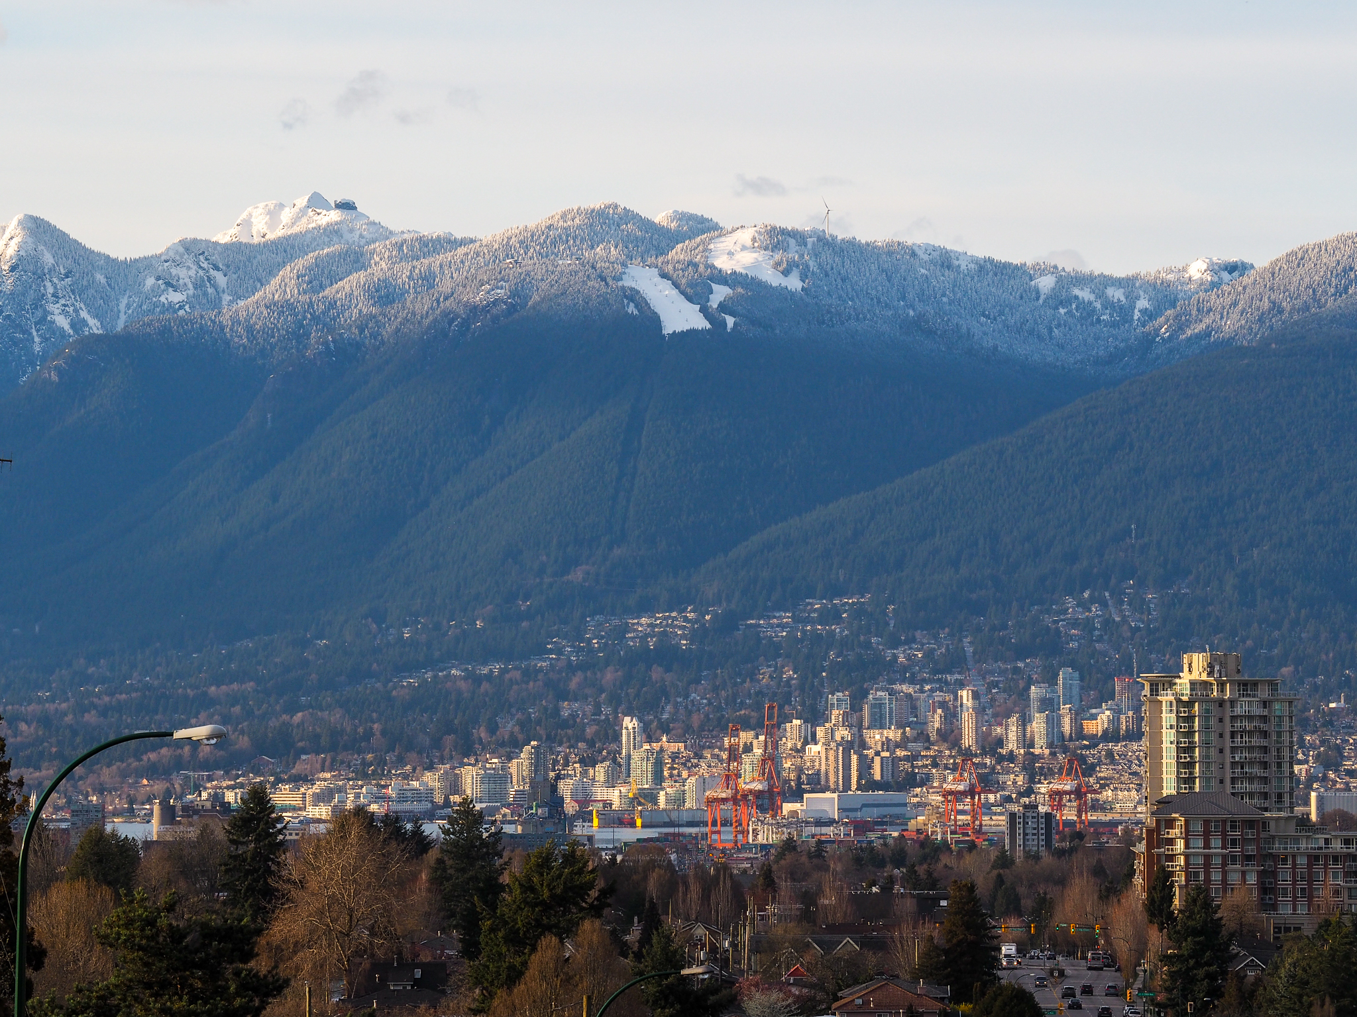
Grouse Mt.
(Vancouver)

Slide 3
Practice
 | 1,231m | 3,776m | 8,848m
Mt. Fuji
Grouse Mt.
Mt. Everest
Hints:
Mt. Fuji is taller than Grouse Mt.
Mt. Everest is taller than Grouse Mt..
Mt. Fuji is not the tallest mountain.

Slide 4
Practice
 | 1,231m | 3,776m | 8,848m
Mt. Fuji
Grouse Mt.
Mt. Everest
Step 1:
Mt. Fuji is taller than Grouse Mt..
Mt. Fuji can’t be the shortest mountain.
Grouse Mt. can’t be the tallest.
X
X

Slide 5
Practice
 | 1,231m | 3,776m | 8,848m
Mt. Fuji
Grouse Mt.
Mt. Everest
Step 2:
Mt. Everest is taller than Grouse Mt..
Mt. Everest can’t be the shortest mountain.
So, Grouse must be the shortest.
Because Grouse is 1,231m it can’t be 3,776m.
X
O
X
X
X

Slide 6
Practice
 | 1,231m | 3,776m | 8,848m
Mt. Fuji
Grouse Mt.
Mt. Everest
Step 3:
Mt. Fuji is not the tallest mountain.
So, Mt. Everest must be the tallest.
Because Mt. Everest is the tallest, Mt. Fuji must be in the middle.
X
O
X
O
X
X
X
X
O

Slide 7
Practice
 | 1,231m | 3,776m | 8,848m
Mt. Fuji | x | o | x
Grouse Mt. | o | x | x
Mt. Everest | x | x | o
Step 4:
Write one sentence for each mountain.
1. Mt. Fuji is taller than Grouse Mt..
2. Grouse Mt. is the shortest of the three mountains.
3. Mt. Everest is the tallest of the three mountains.

