Slide 1

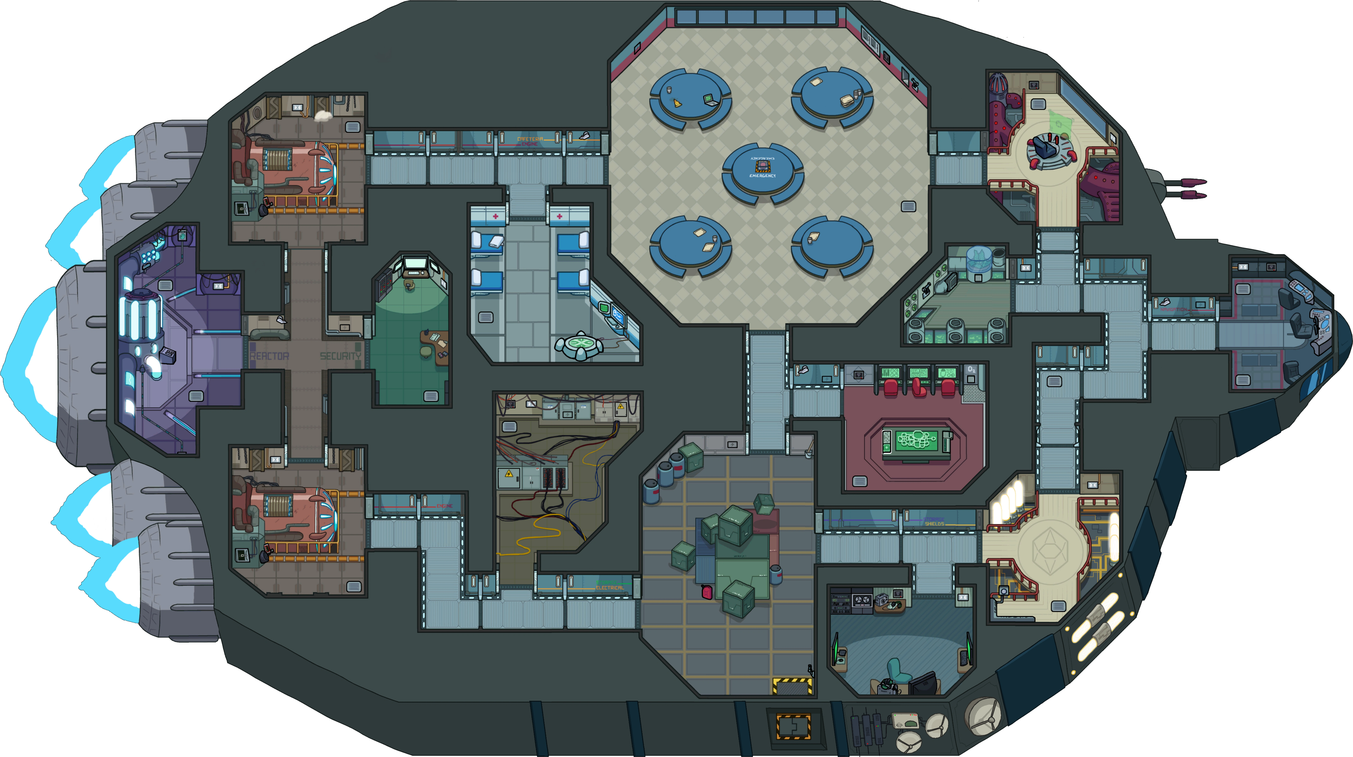

Weapons
Medical
Reactor
Admin
Garbage

